Slide 1
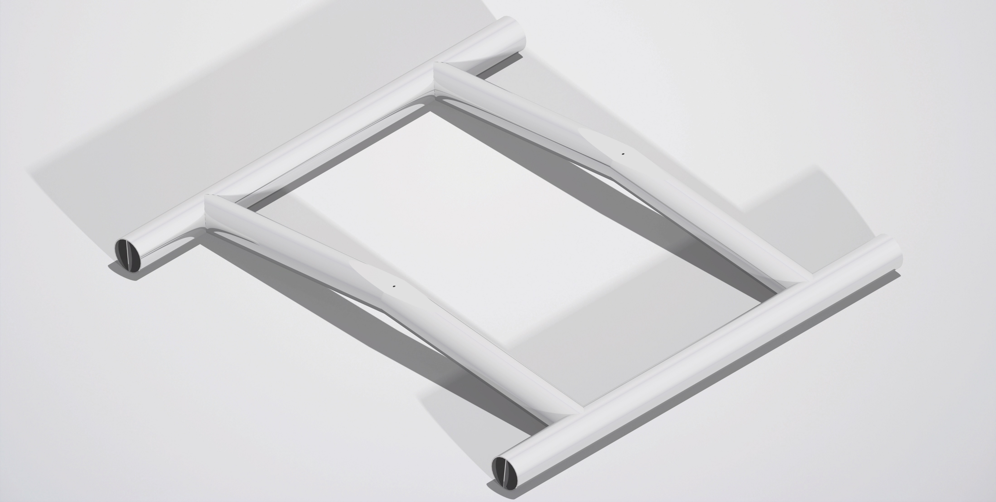
Landing Gear
Impact absorption from 0.33m
Helicopter Skid Gear

